Slide 1
Java Servlets 3.0
Lesson 4:
RequestDispatcher
Notes:
Add instructor notes here.

Slide 2
Lesson Objectives
In this lesson, we will learn:
Request Dispatcher
Server / Client side dispatch
Communication and sharing data between servlets
Notes:
Lesson Objectives:
This lesson introduces Inter-Servlet communication. The lesson contents are:
Lesson 07: Inter-Servlet communication
7.1: Introduction and Need for Inter-Servlet Communication
7.2: Server / Client side dispatch
7.3: Communication and sharing data between servlets
Explain the lesson coverage

Slide 3
4.1: Request Dispatcher Inter-servlet Communication
In a web application, there are multiple web components running on the same server. A web component can invoke another resource while it is executing.
Communication between servlets for exchanging data or sharing control is called inter-servlet communication
Three reasons for using inter-servlet communication are
Direct servlet Manipulation
Servlet reuse
Servlet Collaboration
Notes:
Introducing Inter-Servlet Communication:
The communication between servlets is called Inter-Servlet Communication. In fact, servlet being a web component can invoke another web component like html, jsp and other servlets too.
Servlets running together in the same server communicate with each other in several ways.
The three major reasons for using inter-servlet communication are:
Direct servlet manipulation : allows gaining access to the other currently loaded servlets and performing certain tasks (through the ServletContext object)
Servlet reuse : allows the servlet to reuse the public methods of another servlet
Servlet collaboration : requires to communicate with each other by sharing specific information (through method invocation). Basically servlets collaborate with each another for exchanging data and sharing control.
In this lesson, we shall be focusing on servlet collaboration
Explain different web components running on the server giving shopping cart example, viz servlets, jsps, html.
Explain why is communication amongst these web components is required.

Slide 4
4.2: Server / Client side dispatch Invoking Web Resources
A web component can directly invoke another resource while it is executing, in two ways:
It can forward the request to another resource
The component can include the content of another resource
To invoke a web resource available on the server, one must first obtain a RequestDispatcher object using either a request object or the SessionContext.
RequestDispatcher ServletRequest.getRequestDispatcher(String path)
RequestDispatcher ServletContext.getRequestDispatcher(String path)
Notes:
Introducing Inter-Servlet Communication:
Invoking other Web Resource:
RequestDispatcher is an interface, implementation of which defines an object that receives requests from the client and sends them to any resource (such as a servlet, HTML file, or JSP file) on the server. The servlet container creates the RequestDispatcher object which is used as a wrapper around a server resource located at a particular path or given by a particular name.
This interface is intended to wrap servlets, but a servlet container can create RequestDispatcher objects to wrap any type of resource.
RequestDispatcher object can be obtained from either a Request Object or the ServletContext object as seen in the method signatures above.
Let us first see the concept of dispatching with ServletContext object
Talk about invoking web resource directly where component can be included or control can be transferred to other resource for processing by using URL.
Introduce Request dispatching and tell them we will be seeing these in detail in further slides.
Also inform participants that we will be deviating a bit to learn more about the ServletContext object and the RequestDispatcher Object

Slide 5
4.2: Server / Client side dispatch Concept of ServletContext
The ServletContext is an interface which helps us to communicate with the servlet container.
The ServetContext is created by the container when the web application is deployed
There is only one context per web application. The information in the ServletContext will be common to all the components.
ServletContext object can be obtained by:
ServletContext context = getServletContext();
Notes:
RequestDispatcher Interface:
ServletContext:
There is only one ServletContext for the entire web application and the components of the web application can share it. The information in the ServletContext will be common to all the components.
Remember that each servlet will have its own ServletConfig. The ServetContext is created by the container when the web application is deployed and after that only the context is available to each servlet in the web application
Explain servlet context giving an example of any webapp folder. Convey there is only single context for the application. Differentiate ServletConfig and ServletContext object. In fact, point out that the getServletContext() method is called on the ServletConfig object which has already been implemented by GenericServlet class

Slide 6
4.2: Server / Client side dispatch Creation of RequestDispatcher
RequestDispatcher object can be obtained using getRequestDispatcher() method of either:
ServletRequest object
RequestDispatcher ServletRequest.getRequestDispatcher(String path)
ServletContext object
public RequestDispatcher ServletContext.getRequestDispatcher(/String path)
RequestDispatcher object can also be obtained using getNamedDispatcher() of ServletContext object :
RequestDispatcher ServletContext.getNamedDispatcher(String name)
Notes:
RequestDispatcher Interface:
Creation of RequestDispatcher:
The ServletRequest.getRequestDispatcher() can take a relative path while ServletContext.getRequestDispatcher() cannot (It can only take relative to the current context's root).
For example, with ServletRequest below statements are valid:
request.getRequestDispatcher(“./html/first.html") - evaluated relative to the path of the request
request.getRequestDispatcher("/html/first.html") - evaluated relative to the root
With ServletContext only :
context.getRequestDispatcher("/html/first.html") is valid but not
context.getRequestDispatcher("./html/first.html") i.e. it can not evaluate a path other than context root.
The ServletContext.getNamedDispatcher() method takes a String argument indicating the name of a servlet known to the ServletContext. If a servlet is found, then it is wrapped with a RequestDispatcher object and the object is returned. If no servlet is associated with the given name, then the method returns null. (A servlet instance can determine its name using ServletConfig.getServletName()).
RequestDispatcher allows for direct communication between web resources.
Explain in detail creation of RequestDispatcher and difference between the two ways of creating request dispatcher. Ask them if what is relative and absolute path in relating to the context root.
Thus, ServletContext.getRequestDispatcher(String path) and ServletRequest.getRequestDispatcher(String path) - they both do the same thing, but impose slightly different constraints on the argument path.
For the former, it looks for the resource in the same webapp to which the invoking servlet belongs and the pathname specified can be relative to invoking servlet. For the latter, the pathname must begin with '/' and is interpreted relative to the root of the webapp.

Slide 7
4.2: Server / Client side dispatch Creation of RequestDispatcher
The ServletContext and ServletRequest methods that create RequestDispatcher objects using path information allow the optional attachment of query string information to the path.
For example:
ServletContext context = getServletContext();
String path = "/raisins.html?orderno=5";
RequestDispatcher rd = context.getRequestDispatcher(path);
Notes:
RequestDispatcher Interface:
Creation of RequestDispatcher:
Parameters specified in the query string used to create the RequestDispatcher take precedence over other parameters of the same name passed to the included servlet. The parameters associated with a RequestDispatcher are scoped to apply only for the duration of the include or forward call.
Rd also allows to append query string to the path. Convey precedence and scope of the parameters passed with RD

Slide 8
4.2: Server / Client side dispatch Using RequestDispatcher
A RequestDispatcher object can forward a client’s request to a resource or include the resource itself in the response back to the client. It defines two methods for performing the above tasks: forward() and include()
For example:
@WebServlet("/Dispatcher")
public class Dispatcher extends HttpServlet {
public void doGet(HttpServletRequest req, HttpServletResponse res) {
RequestDispatcher dispatcher =
request.getRequestDispatcher("template.html");
if (dispatcher != null)
dispatcher.forward(request, response);
}
}
Notes:
RequestDispatcher Interface:
Using RequestDispatcher:
A RequestDispatcher object can forward a client’s request to a resource or include the resource itself in the response back to the client. A resource can be another servlet, HTML file or a JSP file. Methods are:
public void forward(ServletRequest req, ServletResponse resp)
public void include(ServletRequest req, ServletResponse resp)
The forward() method of the RequestDispatcher interface may be called by the calling servlet only when no output has been committed to the client. If non-committed output data exists in the response buffer, the content must be cleared before the target servlet's service method is called. Else, an IllegalStateException will be thrown.
In the case of forward() , once another web resource is being invoked , we cannot access the previous web resource.
include() includes the content of a resource in the response. The included servlet cannot change the response status code or set headers; any attempt to make a change is ignored.
The target servlet of the include() method has access to all aspects of the request object, but its use of the response object is more limited. It can only write information to the ServletOutputStream or Writer of the response object and commit a response by writing content past the end of the response buffer, or by explicitly calling the flushBuffer() method of the ServletResponse interface. It cannot set headers or call any method that affects the headers of the response.
In the case of include() , once another web resource is being invoked , we can come back with the response embedded to access the previous web resource.
Working with the RequestDispatcher is called as Server side dispatch. This is because the container is responsible to either forward request to other servlet or include the response of another servlet.
In both of these methods URL pattern does not change. Thus client is not aware which servlet is processing the request.
We introduce multiple servlets here as a single servlet may not be able to complete the request processing life cycle, or we may require it for load balancing.
Explain them code given in the slide for forward() and include(). Make sure to emphasis checking for null in the code. Also ensure to convey them about the usage of forward method before response is committed.
Also, ask participants to notice how request and response objects are implicitly sent to target resource

Slide 9
4.2: Server / Client side dispatch Sending Request & Response objects
The ServletRequest object also exposes three methods to pass/retrieve/remove parameters between requests.
setAtttribute()
getAttribute()
removeAttribute()
For eg:
protected void doGet(HttpServletRequest req, HttpServletResponse res) {
req.setAttribute("exception", new ItemNotFoundException());
getServletContext().getRequestDispatcher("/errorservlet")
.forward(req, res);
}
Notes:
Communication with Server Resources:
Notice that the forward() and include() methods have the Request and Response objects as parameters. Thus one servlet can easily pass its Request and Response objects to the target servlet, and thus any request parameters too. However, if user wishes to pass more request parameters and also between just a request, use the setAttribute() method of the ServletRequest object. The ServletRequest object also exposes the getAttribute() and removeAttribute() methods, the likes of which has been discussed earlier.
See the code snippet in the slide above. The setAttribute() method sets an attribute named “exception” to a new instance of an exception – ItemNotFoundException. The forward() method while carrying request information will also carry this new attribute to the target servlet!
Thus to communicate among servlets and pass data between them we can make use of Request object and its API methods mentioned in the slide.

Slide 10
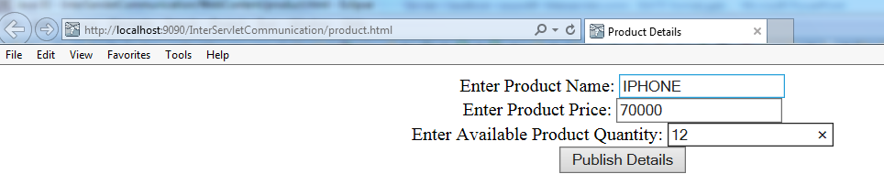
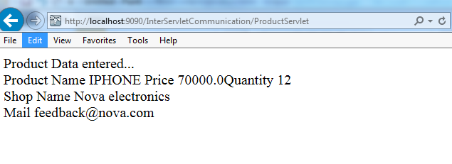
Demo
Creating request attributes and retrieving them using [set/get]Attribute method
ProductServlet, DisplayProductInfo, product.html
Notes:
Note:
Refer to ProductServlet, DisplayProductInfo, product.html partial code below:
Execute the code by invoking the product.html first and fill in required fields. Data is fetched into ProductServlet and then forwarded to DisplayProductInfo servlet
Run the servlet after explaining the code. Show the request info returned in the DisplayProductInfo servlet.

Slide 11
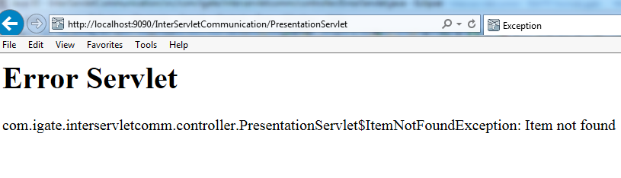
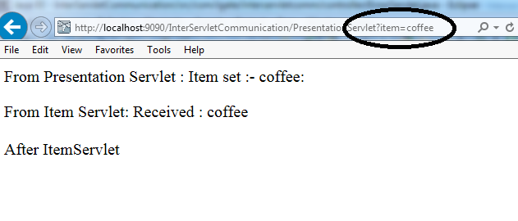
Demo
Working with include method of RequestDispatcher
PresentationServlet, ItemServlet, ErrorServlet
Notes:
Note:
Refer to PresentationServlet, ItemServlet, ErrorServlet partial code below:
Execute the code by invoking the PresentationServlet with no item appended as query parameter.
Then execute PresentationServlet with item appended as query parameter
http://localhost:9090/InterServletCommunication/PresentationServlet
By appending item as query parameter
http://localhost:9090/InterServletCommunication/PresentationServlet?item=coffee
Here the response of ItemServlet is included in PresentationServlet
Run the servlet after explaining the code. Show how the include method is used

Slide 12
4.2: Server / Client side dispatch Client side Dispatch
In Client side dispatch, method used is response.sendRedirect(“URL Pattern”);
With this method, a new request is generated and the request-response lifecycle is started again
Notes:
Client Side Dispatch
Make use of method, response.sendRedirect(“URL Pattern”);
In this, a servlet may not be able to process the request completely and sends it back to the browser with HTTP Response Code as 300 for Redirection.
This will result in a new URL to be created and start of another Request-Response lifecycle.
The URL pattern will change in browser as contrast to Server side dispatch
Explain the usage of response.sendRedirect(“URL Pattern”);

Slide 13
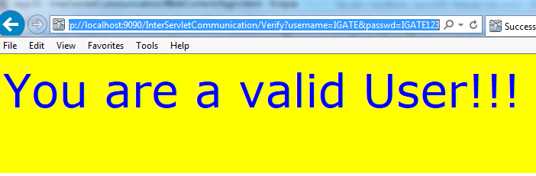
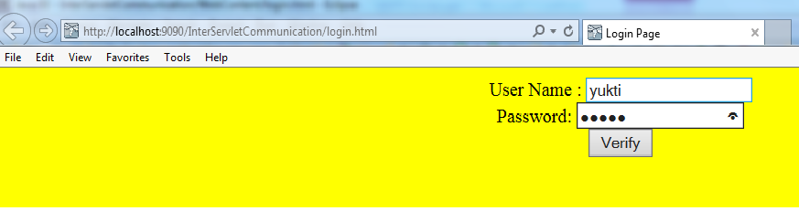
Demo
Execute login.html, Verify.java, success.html
Notes:
Run the URL Pattern: http://localhost:9090/InterServletCommunication/login.html
If user credentials are valid, display Success.html page
And if invalid user credentials display -> login.html back
Run the servlet after explaining the code. Show how resposne.sendRedirect(“URL Pattern”) affects the URL Pattern

Slide 14
4.2: Server / Client side dispatch Comparison
Server – Side Dispatch | Client – Side Dispatch
Container is responsible for dispatch | Browser is responsible for redirect
RequestDispatcher interface used with forward and include methods, with URL Pattern specified | Response.sendRedirect(“URL Pattern”) method is used
URL Pattern in browser during Request-Response lifecycle does not change | URL Pattern in browser during Request-Response lifecycle changes
It is an cheap process | It is expensive process
Forward / Include can happen only within the same Web application | Redirection can happen in same web application as well as to another URL (outside web application) also
Data can be transferred easily between web components by making use of Request object API like request.setAttribute(String s,Object); and request.getAttribute(String s); | Data transferring here becomes tricky due to the new Request-Response lifecycle. However we could make use of ServletContext object for data sharing among web components

Slide 15
4.3: Communication and Sharing Data between Servlets Sharing Data between Servlets
Servlet Context API allows sharing named objects between all the servlets in a servlet context, by binding the objects to the servlet context object.
Methods of Servlet Context API :
void ServletContext.setAttribute(String s, Object o)
Object ServletContext.getAttribute(String s)
void ServletContext.removeAttribute(String s)
Enumeration ServletContext.getAttributeNames()
Notes:
Sharing Data between Servlets:
One of the reasons for inter-servlet communication that we listed is to share data between the servlets. Servlet API offers way of sharing named objects between all the Servlets in a Servlet context (and also other contexts, as we'll see in next page) by binding the objects to the ServletContext object which is shared by several Servlets.
The ServletContext class has several methods for accessing the shared objects:
public void setAttribute(String name, Object object) adds a new object or replaces an old object by the specified name. The attribute name should follow the same naming convention as a package name.
Just like a custom ServletRequest attribute, an object which is stored as a ServletContext attribute should also be serializable to allow attributes to be shared by Servlets which are running in different JVMs on different machines in a load-balancing server environment.
public Object getAttribute(String name) returns the named object or null if the attribute does not exist.
Give them the scenario where data sharing is a requirement, could be banking application, shopping cart application.
And then talk about how is it done using context/request attributes.

Slide 16
4.3: Communication and Sharing Data between Servlets Sharing Information: Usage
Setting the context, request information:
Getting this context, request information in the included servlet:
ServletContext sc=getServletContext();
sc.setAttribute("company“ , “IGATE");
req.setAttribute(“coursename",”J2EE");
sc.getRequestDispatcher("/print").forward(req , res);
ServletContext sc=getServletContext();
out.println(" context variables (application) " +"<br>");
out.println("company " + " : " +sc.getAttribute("company") +"<br>");
out.println(" Request attributes " +"<br>");
out.println("name" + " : " +req.getAttribute(“coursename"));
Notes:
Sharing Data between Servlets:
Sharing Information: Usage
In addition to the user-defined attributes, there may also be predefined attributes that are specific to the Servlet engine and provide additional information about a Servlet(Context)'s environment.
public Enumeration getAttributeNames() returns an Enumeration of the names of all available attributes.
public void removeAttribute(String name) removes the attribute with the specified name if it exists.
The separation of Servlets into Servlet contexts depends on the Servlet engine. The ServletContext object of a Servlet with a known local URI can be retrieved with the method public ServletContext getContext(String uripath) of the Servlet’s own ServletContext. This method returns null if there is no Servlet for the specified path or if this Servlet is not allowed to get the ServletContext for the specified path due to security restrictions.
Explain the code snippet given for sharing attributes.
Explain how this code snippet shows passing both – request as well as servletContext variables across to target servlet…

Slide 17
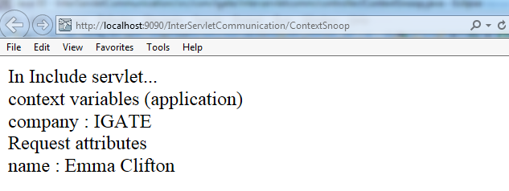
Demo
Creating context attributes and retrieving them using [set/get]Attribute method
ContextSnoop.java
PrintServlet.java
Notes:
Note:
Refer to the ContextSnoop Servlet and Include servlet; partial code of both given below:
ContextSnoop.java
PrintServlet.java :
Execute the ContextSnoop servlet as :
http://localhost:9090/InterServletCommunication/ContextSnoop
Notice how the ContextSnoop servlet first sets the request-level and ServletContext-level attributes and then forwards to print servlet!
For the curious, invoke the Print servlet directly; and see what happens
Run the servlet after explaining the code. Show the request as well as context info returned in the print servlet.

Slide 18
Summary
In this lesson, we have learnt:
Inter-Servlet Communication
RequestDispatcher Interface
Communication with Server Resources
Sharing data between servlets
Notes:
Add the notes here.
Summarize the chapter by briefly mentioning what all is learnt.

Slide 19
Review Question
Question 1: Which of the following can be used to obtain RequestDispatcher object?
Option 1: ServletConfig.getRequestDispatcher()
Option 2: ServletRequest.getRequestDispatcher()
Option 3: ServletResponse.getRequestDispatcher()
Option 4: ServletContext.getRequestDispatcher()
Notes:
Add the notes here.
Answers for the Review Questions:
Answer 1: ServletRequest.getRequestDispatcher() and ServletContext.getRequestDispatcher()

Slide 20
Review Question
Question 2: What is the difference between include() and forward() of RequestDispatcher ?
Option 1: Forward() transfers a request from a servlet to another resource on the server while include() embeds the content of a resource in the response
Option 2: Forward() embeds the content of a resource in the response while include() transfers a request from a servlet to another resource on the server
Notes:
Add the notes here.
Answers for the Review Questions:
Answer 2: first option

Slide 21
Review Question
Question 3: How is the data shared between servlets ?
Option 1: Using put/get value methods of Servlet Context
Option 2: Using set/get Attribute methods of ServletContext
Option 3: Using value bound/unbound methods
Option 4: Using set/get attribute methods of ServletResponse
Notes:
Add the notes here.
Answers for the Review Questions:
Answer 3: Using set/get Attribute methods of ServletContext

